Slide 1
AI Preparedness Index
Ghana, Africa and the World

Slide 2
Problem
OpenAI, Claude, Gemini, Grok, Deepseek have popularized the artificial intelligence era from 2022 till date. However, there is a significant "AI Divide" globally.
While advanced economies are rapidly integrating AI into their infrastructure and labor markets, developing nations, particularly in Africa face foundational hurdles.
This project examines where Ghana stands on AI readiness, what's holding it back, and what it would take to close the gap with leading countries using data from IMF, 2023

Slide 3
AI Preparedness Index
AI preparedness Index (AIPI) measures how countries are positioned to adopt and integrate artificial intelligence.
It is built on four macro-structural pillars: Digital Infrastructure, Human Capital, Innovation, and Regulation.
The data assesses the level of AI preparedness across 174 countries globally and scores economies from 0 to 1 based on the structural pillars.

Slide 4
Top 10 African Countries AIPI
Country | Seychelles | Mauritius | South Africa | Tunisia | Kenya | Rwanda | Cabo Verde | Morocco | Ghana | Namibia
AIPI | 0.530653 | 0.525113 | 0.496765 | 0.465410 | 0.445192 | 0.437400 | 0.432587 | 0.429111 | 0.425200 | 0.419612
AIPI % | 53.07% | 52.51% | 49.68% | 46.54% | 44.52% | 43.74% | 43.26% | 42.91% | 42.52% | 41.96%
Rank | 1 | 2 | 3 | 4 | 5 | 6 | 7 | 8 | 9 | 10
Ghana ranks 9th out of 10 in Africa

Slide 5
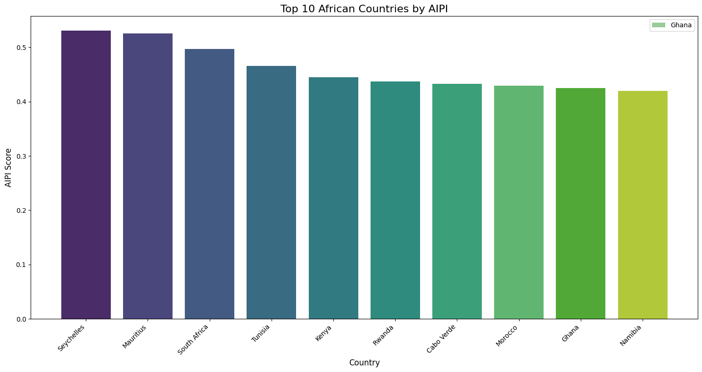

Slide 6
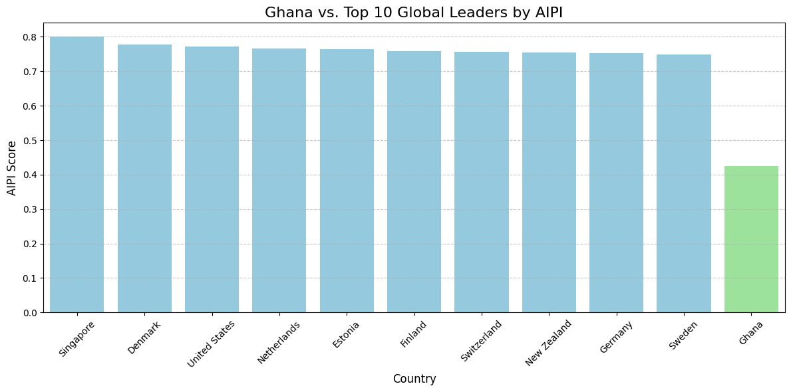

Slide 7
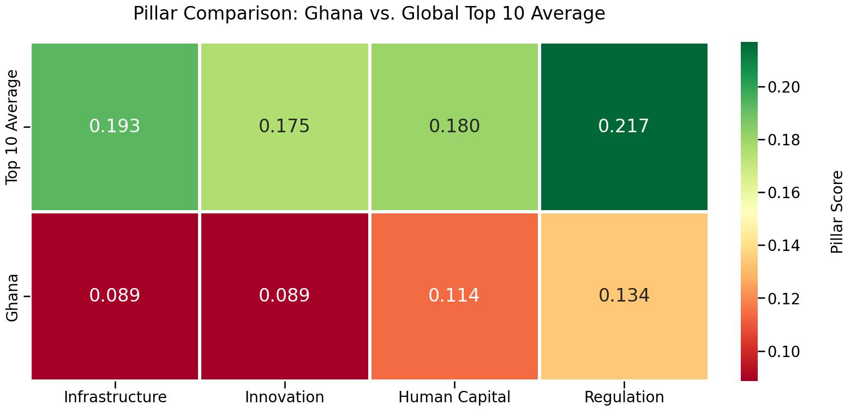

Slide 8
Heatmap Explanation
Regulation and Ethics: This is Ghana's highest-scoring pillar (0.134). While still significantly lower than the global leaders' average (0.217), it represents the area where Ghana has its strongest framework for AI preparedness.
Digital Infrastructure: This is the area with the widest relative gap. The global leaders average 0.193, while Ghana is at 0.089. This suggests that foundational access to high-speed internet and reliable data centers remains the most critical barrier for Ghana.

Slide 9
Heatmap Explanation
Human Capital: Ghana's score of 0.114 compared to the leaders' 0.180 indicates a need for continued investment in digital literacy and specialized AI skills within the workforce.
Innovation and Economic Integration: Ghana scores 0.089 here, nearly half of the global average (0.175). This reflects the challenges in integrating AI into the local business ecosystem and fostering home-grown tech innovation.

Slide 10
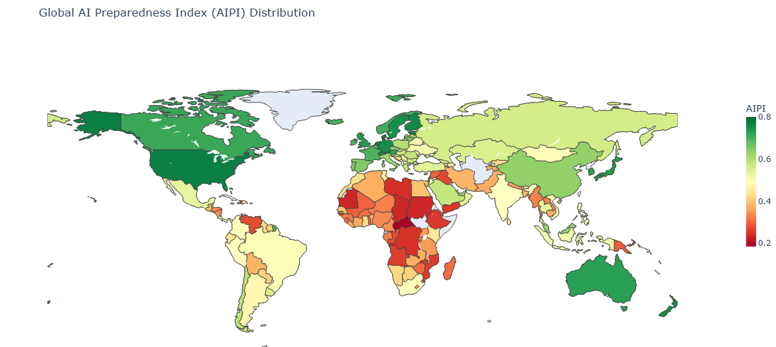

Slide 11
GMT TEAM
THANK YOU

